Slide 1
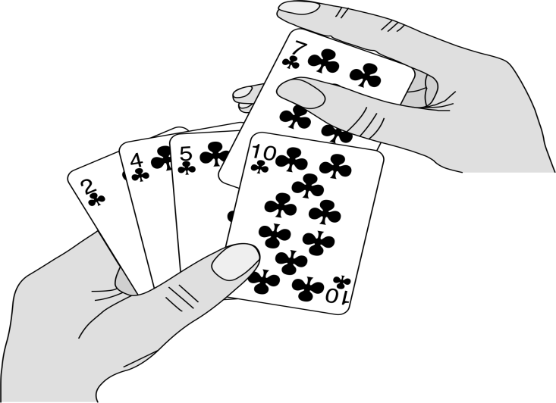
Insertion Sort in Details
Is an efficient algorithm for sorting a small number of elements.
In cards game, we remove one card at a time from the table and insert it into the correct position in the left hand.
To find the correct position for a card, we compare it with each of the cards already in the hand, from right to left.
At all times, the cards held in the left hand are sorted.

Slide 2
INSERTION-SORT Procedure
Takes as a parameter an array A[1..n] containing a sequence of length n that is to be sorted.
The algorithm sorts the input numbers in place: it rearranges the numbers within the array A, with at most a constant number of them stored outside the array at any time.
The input array A contains the sorted output sequence when the INSERTION-SORT procedure is finished.

Slide 3
(a)–(e) The iterations of the for loop of lines 1–8.
In each iteration, the black rectangle holds the key taken from A[j], which is compared with the values in shaded rectangles to its left in the test of
line 5.
Shaded arrows show array values moved one position to the right in line 6, and black arrows indicate where the key moves to in line 8.
(f) The final sorted array.

